Slide 1



Price Optimization
In Retail Industry
Develop an AI system that dynamically adjusts product pricing based on demand, competition, and other market factors to maximize profitability.
2024F-T3_AISC2013_01-Group C

Slide 2
Team Members
Student Name | Student ID
Abhishek Pandey | 500227770
Ram Krishna Dhakal | 500228601
Bibek Khadka | 500216129
Govind Ram Gupta Belde | 500228074
Kamalpreet Kaur | 500227884

Slide 3
TABLE OF CONTENTS
01
02
03
04
Summary
Docker & Jenkin
Ansible
Frontend(Streamlit)

Slide 4
TIMELINE
Pre-Processing and Model Tuning
UI and Final Deployment
Mid Term
Final
CASE STUDY 1
CASE STUDY 2
Data Source Identification
Docker, Jenkin, Ansible & Streamlit Setup

Slide 5
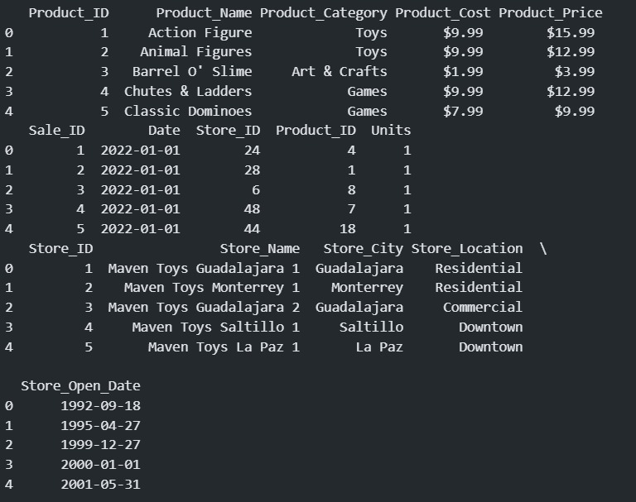
About the Data:
Our Dataset is a Maven toy store data set with around 800,000 rows and 13 features.
We have performed initial preprocessing and feature extraction(month & year).
Added profit feature
Product cost and product price as our target variables.
Trained the random forest regressor model for initial testing later we will train the Neural Network models.

Slide 6
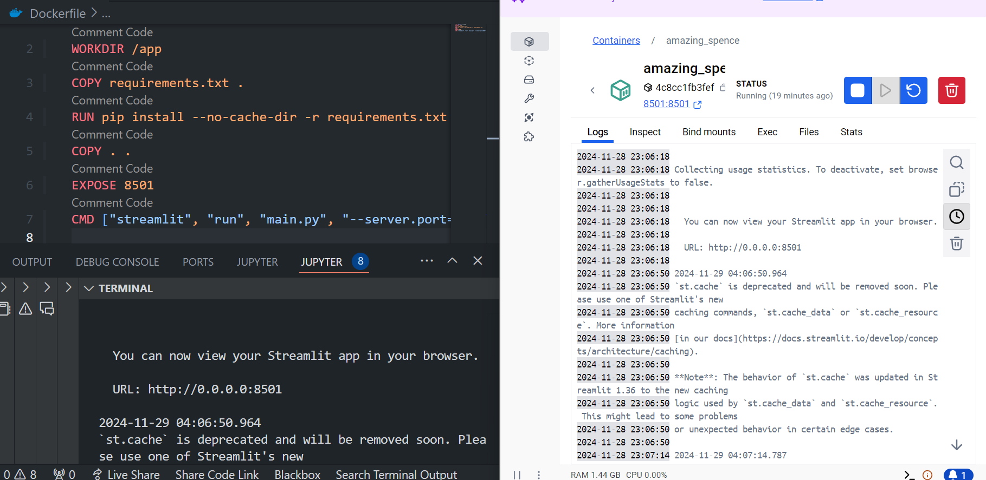
Docker Setup

Slide 7
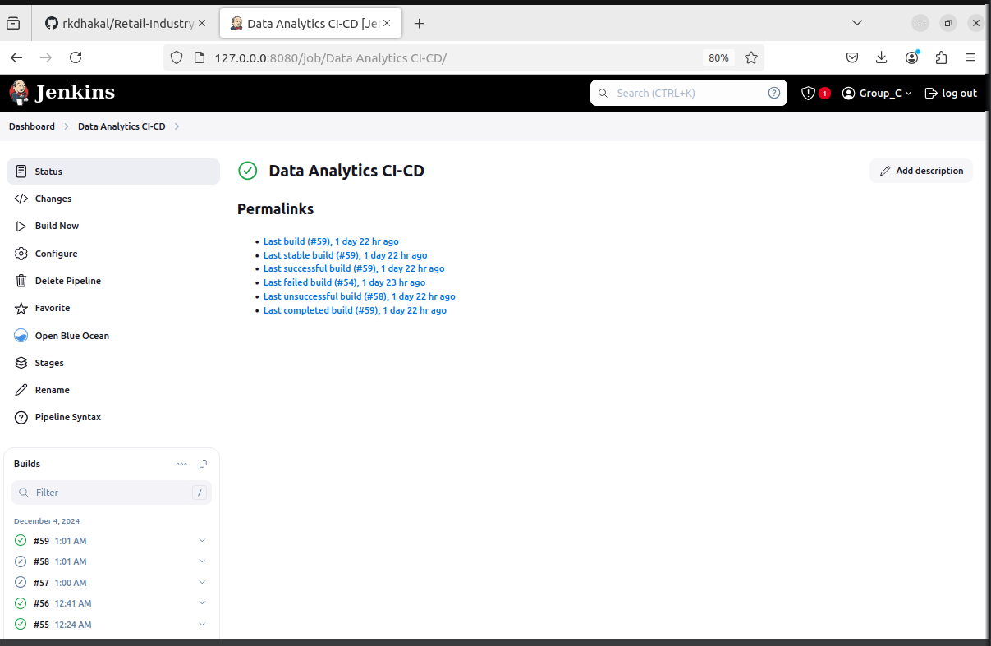
Jenkins Setup

Slide 8
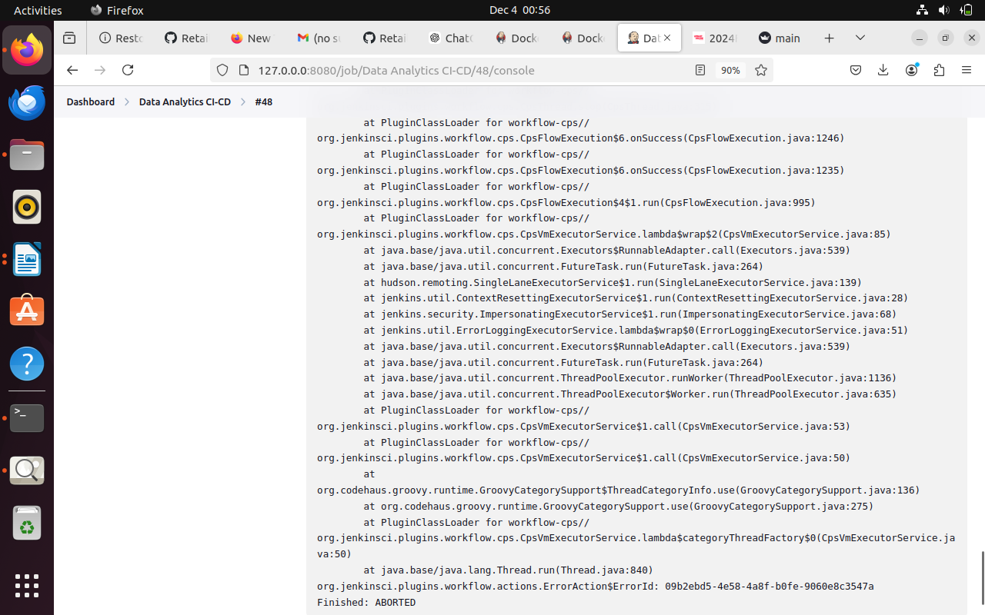
Java Error

Slide 9
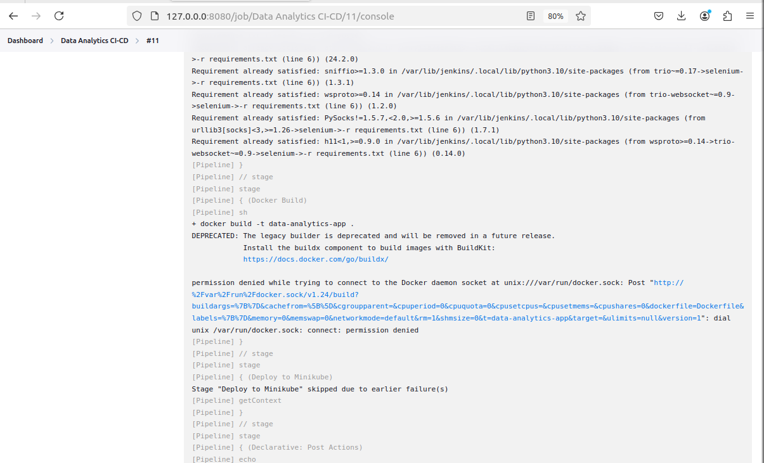
Docker Permission Issue

Slide 10
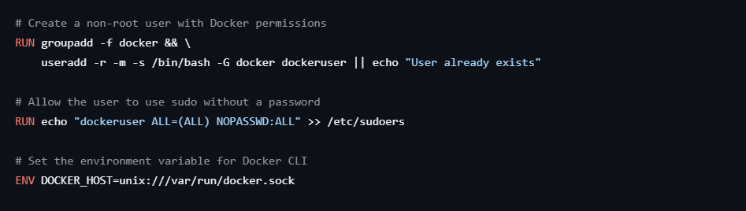
Solution

Slide 11
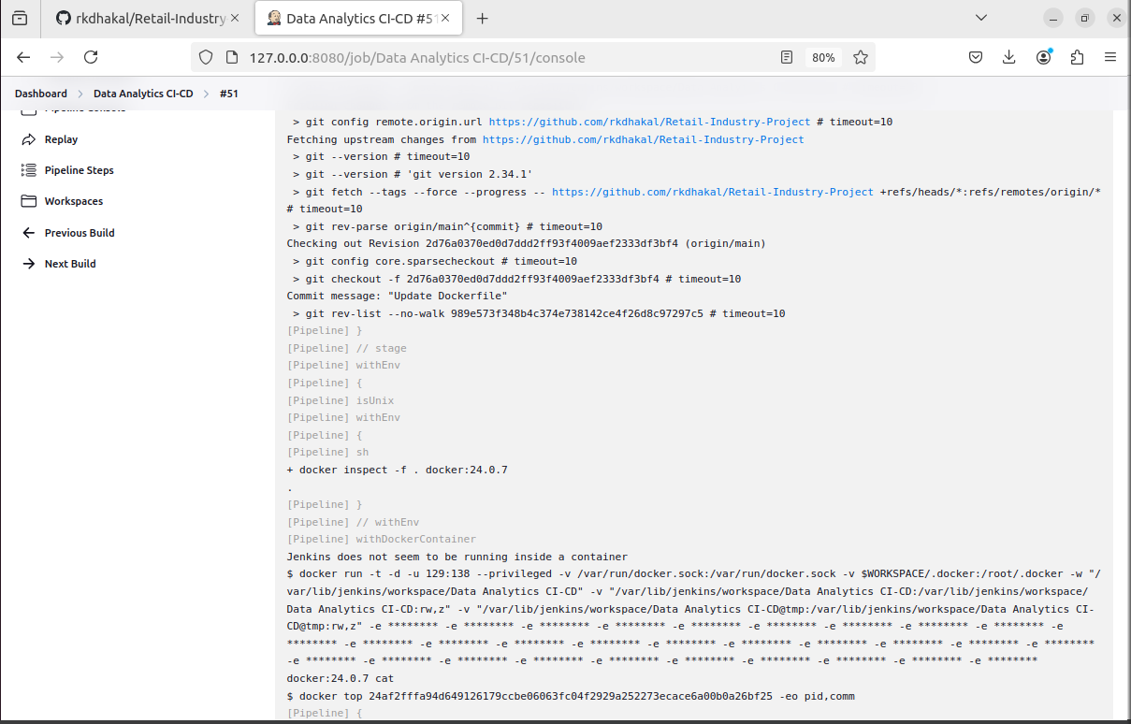
Jenkin Issue

Slide 12
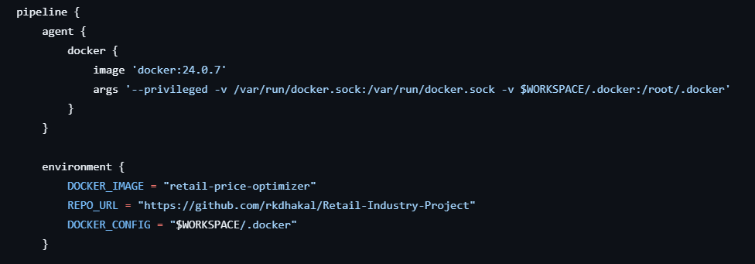
Solution

Slide 13
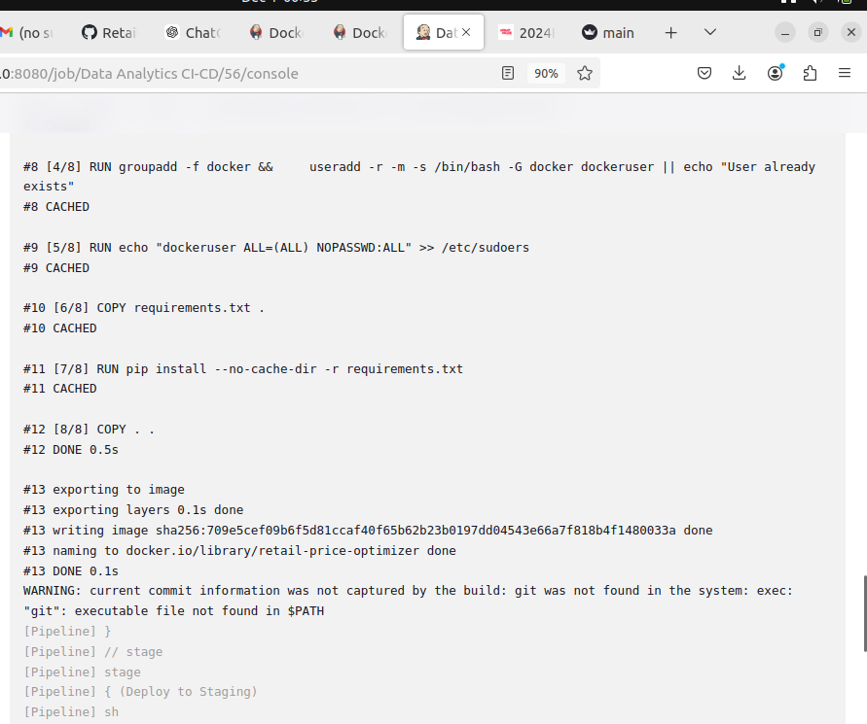
Docker Instantiated

Slide 14
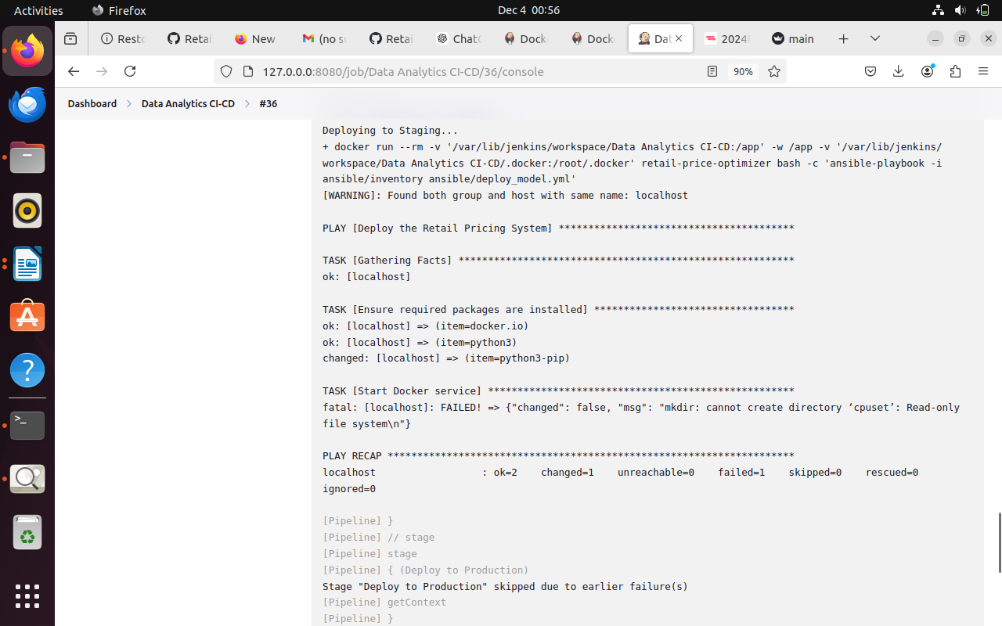
Deploying To Staging

Slide 15
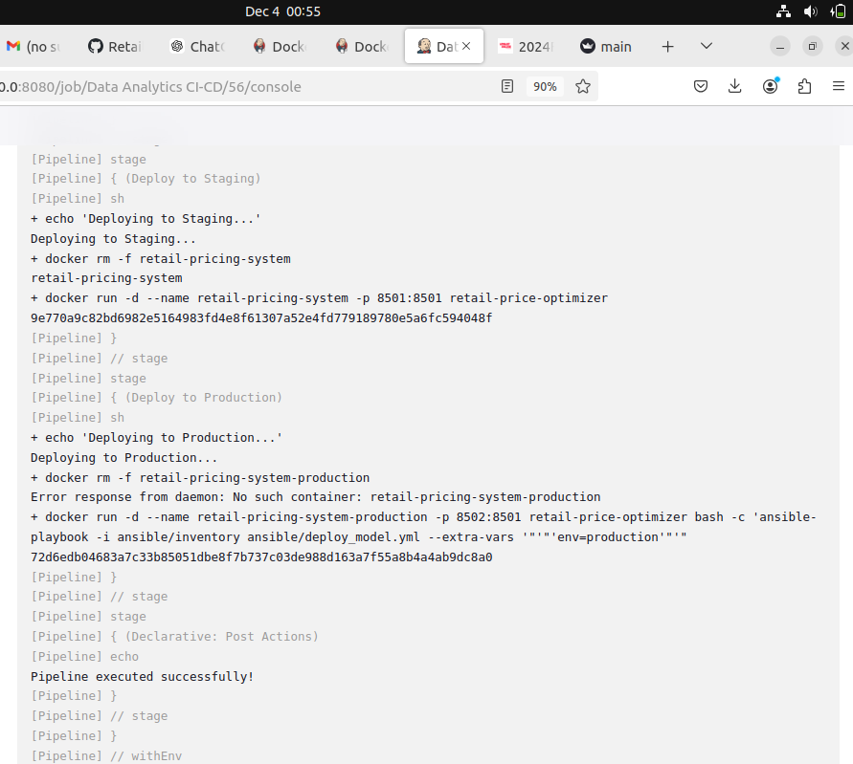
Deploying to Production

Slide 16
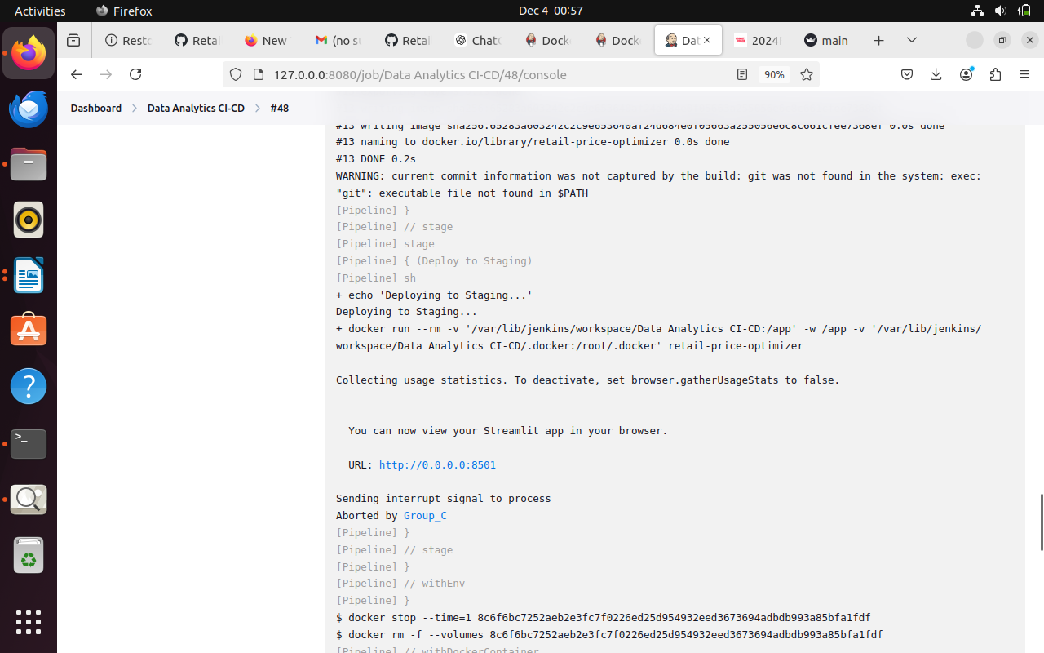
Output

Slide 17
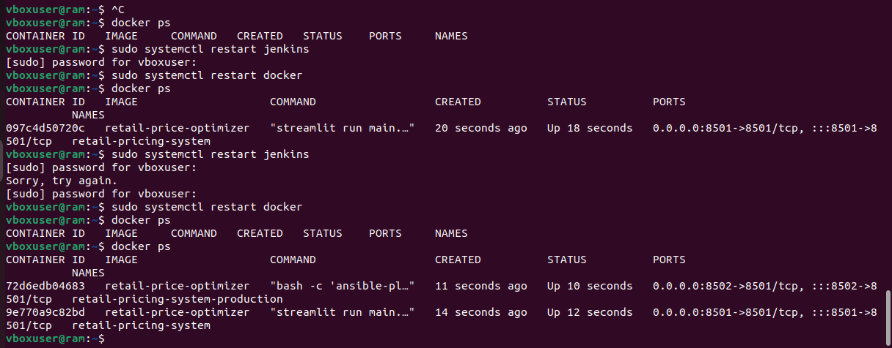
Docker Image

Slide 18
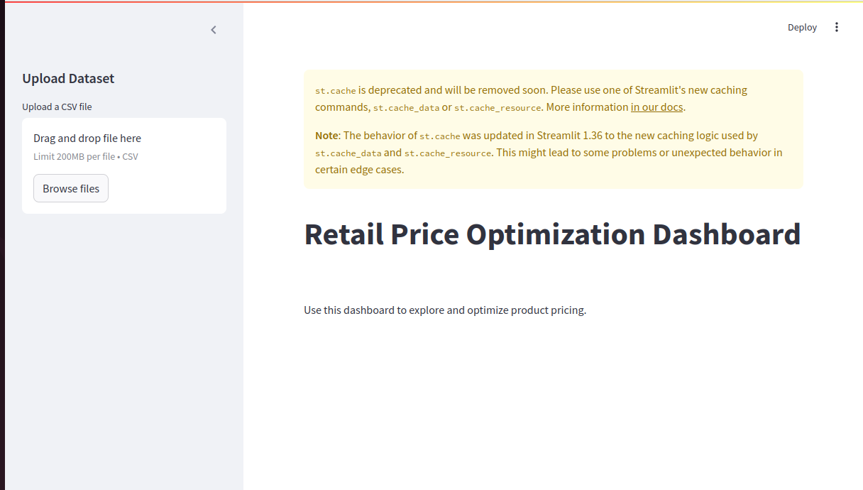
Frontend

Slide 19
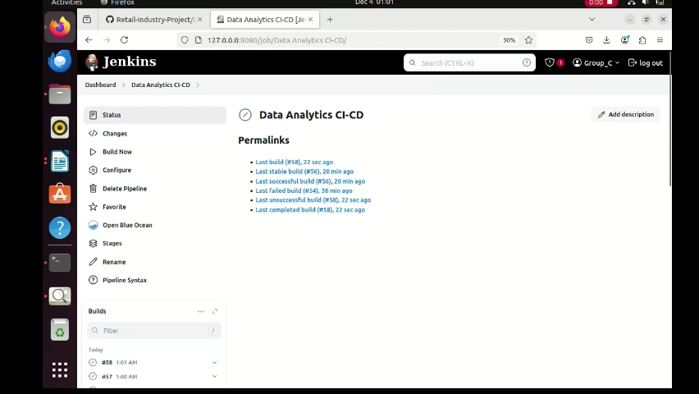

Slide 20
Github Link
https://github.com/rkdhakal/Retail-Industry-Project
Report

Slide 21
THANK YOU
Git Hub

